Slide 1


Alumni and NESA
Awards and Recognition Programs
January 12, 2025
Notes:
Good afternoon and welcome to our webinar on Alumni and NESA awards and recognition. We have quite a bit to cover and we will open it up for questions at the end or you can put them in the chat. We have members of our national staff on as well who can assist answering questions also. This presentation is being recorded and will be posted on the Alumni and the NESA websites in the next week or so. They are Scoutingalumni.org and NESA.org.

Slide 2
Who Are Scouting Alumni?
“Scouting America defines Scouting Alumni as anyone who has ever been personally impacted by Scouting!”
Notes:
Let’s first start with who are Scouting Alumni? It’s anyone who has been impacted by Scouting. It could be the previous charter org rep that is no longer in that position. It could be the person that made it to First Class and left Scouting. It could even be my mom who was a den leader. Basically, it’s anyone who was involved in or supports the Scouting movement.

Slide 3
Why Are Scouting Alumni Important?
Simply put, there are no better “ambassadors” for the Scouting program than Scouting Alumni.
Notes:
Why are our Alumni important? They can be some of our biggest ambassadors or cheerleaders for the program. They are so important in helping support what we do as an organization.

Slide 4
Purpose & Presentations
What is the purpose of these Awards and Recognitions?
Where are these Awards and Recognitions Presented?
To thank – Individuals for a job well done
To incentivize – Others to do more
To acknowledge – The accomplishment of specific activities as described in the award requirements
To promote – Raise visibility and educate various audiences
During an appropriate ceremony
Before an appropriate audience
At an appropriate time
Notes:
Most people know awards are to thank people for their work. However, the purposes go beyond that. We have these awards to help encourage alumni to do more to support Scouting. We also use them to promote Scouting. It’s important to let media outlets be aware of the awards and invite them to the presentation. Also, another purpose is because the individual earned the award. In other words, they put in the work. The awards should be presented at the right time, right place and with the right people.

Slide 5

Alumni
Awards and Recognition
Website Resources (ScoutingAlumni.org)
Alumni Award
Alumnus of the Year Awards
Distinguished and Outstanding Council Alumni Committee Awards
Scouting Alumni Service Commemoration
Council Distinguished Alumnus Award

Slide 6
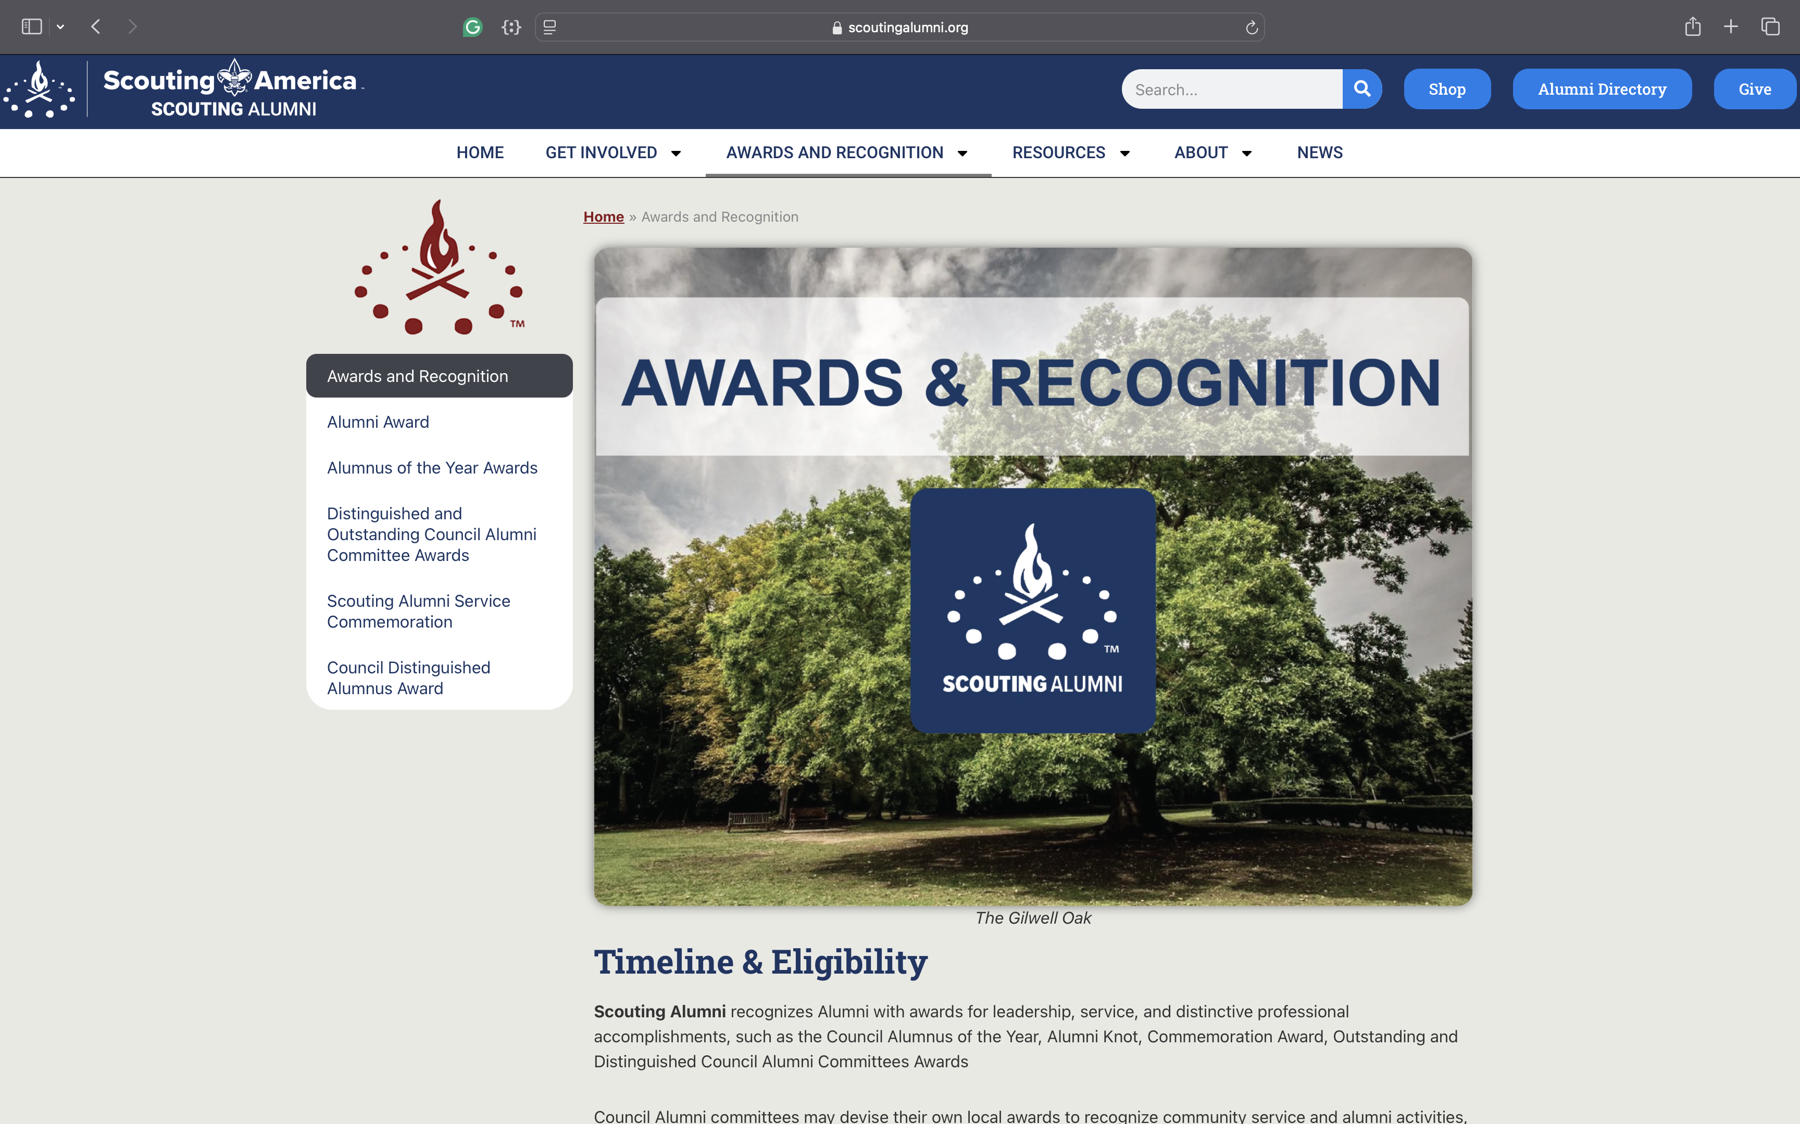
ScoutingAlumni.org
Notes:
Once again, the website is Scoutingalumni.org. This is the landing page for the award and recognition information and applications. There are links at the top for other information and resources too.

Slide 7

Alumni Award
We encourage councils to form an Alumni Committee.
Recipient must be a registered Scouter
Nomination must be approved by the Alumni Committee and Scout Executive
Six Focus Areas – Memories, Marketing, Mentoring, Membership, Manpower, and Money
Notes:
The first award we want to mention is the Alumni Award. This is earned at the council level. The first thing to mention is it needs to be approved by the Alumni Committee. That means you need to actually have a committee. That means a group of individuals. Not just a committee of one. Also, the earn this, you must be registered in Scouting America. There are 6 areas that requirements need to be met. They are Memories, Marketing, Mentoring, Membership, Manpower, and Money. I would encourage you to download the application at Scoutingalumni.org to see what is required in each of those areas and get started on it now. This also requires Scout Exec approval.

Slide 8



Alumnus of the Year Awards
Scouting America annually recognizes individuals with Alumnus of the Year Awards.
These awards are presented at the Council, Territories, and National Levels
At the Council Level, only one person may be nominated per year.
Notes:
The Alumnus of the Year award is presented annually at the Council, Territory, and National level. This award is for both involvement in Scouting Alumni and career or community service. Nominations are submitted to the Council Alumni Committee. So you need to have a committee. A list of recipients at all levels is posted at ScoutingAlumni.org

Slide 9
Alumnus of the Year Awards
Continued…
At the Territories Level, CSTs will be grouped together into the following four (4) geographical groupings: Territories: 1, 3, 8; Territories: 4, 5, 6, 9; Territories: 7, 14, 15, 16; and Territories: 10, 12, 13.
Every effort will be expended to select one recipient from each of the four (4) groupings. However, no two recipients will be selected from the same CST.
At the National Level, only one recipient will be selected.
At all levels, nominations may be submitted anytime during the calendar year but must be received before December 31st to count for that year.
Notes:
This slide shows some of the details of the Alumnus of the Year award. At the territory level, they are combined into 4 groups to assist in selecting 4 awardees. Only one is selected at the National Level.

Slide 10
Distinguished and Outstanding Council Alumni Committee Awards
Presented to Councils for their Alumni Relations efforts
Must sponsor one alumni event, which engages non-active and unregistered alumni
Collaborate with a specific council alumni group in promoting outreach to Alumni
Publish and distribute an alumni-centric communication six times per year
Additional requirements completed determine Outstanding (5 of 10) or Distinguished (7 of 10)
Must have an Alumni Committee to receive Distinguished Award
Notes:
The Distinguished and Outstanding Council award is presented to the council for their alumni efforts. Again, the first step is having a committee. There are a total of 10 requirements and depending on how many are completed determine the difference between Outstanding and Distinguished. 3 requirements are mandatory. Hold an Alumni centric event, collaborate in outreach with an alumni group whether that is NESA, OA, Wood badge or another. And you need to publish some sort of communication at least 6 times a year.

Slide 11
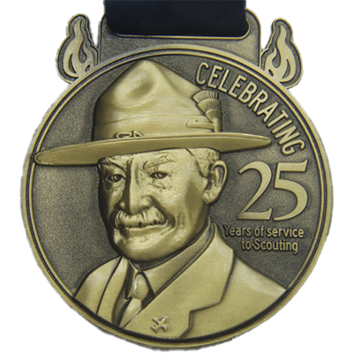
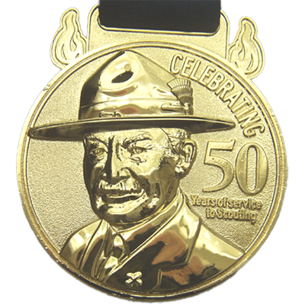
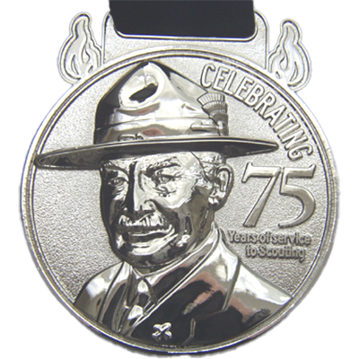
Scouting Alumni Service Commemoration
These are not awards but rather recognitions of service.
The idea is to allow units, districts, or councils to present them in a public setting, but without a formal process.
Years of service are counted using the “On My Honor” system to calculate tenure. Service may include other youth-serving organizations such as Girl Scouts, and Boys & Girls Clubs. There is no application or Scout Executive signature required.
Notes:
The Scouting Alumni Service Commemoration is not an award but is a recognition of years of service. This is similar to the service stars that you can receive. These are available at 3 levels. 25, 50, and 75.

Slide 12

Council Distinguished Alumnus Award
The Council Distinguished Alumnus Award is primarily for those Alumni who have distinguished themselves in their vocation or advocation.
Recipients are selected by the Council Alumni Committee in conjunction with the Scout Executive.
The award may not be given posthumously.
Design Under Development
Notes:
The final Alumni award is the Council Distinguished Alumnus Award. It’s presented to a person, not necessarily registered in Scouting, in recognition of community impact using the skills learned from Scouting. So it promotes the idea of ”Once a Scout, Always a Scout” .There is no such thinks as “aging out”. Scouting becomes part of a foundation for living. It is encouraged to present this in a business or community setting to increase the visibility of Scouting. Once more, the selection is made by the Council Alumni committee. I’m now going to turn this over to Bill Kropa to go through the NESA Awards and Recognitions.

Slide 13
National Eagle Scout Association
Awards and Recognition
Website Resources (nesa.org)
Distinguished Eagle Scout Award
NESA Outstanding Eagle Scout Award
NESA Distinguished Service Award
Silver Wreath Award
Glenn A. & Melinda W. Adams Service Project of the Year Award
NESA Legacy Society
NESA Scholarships
Notes:
Hello, now we will review the National Eagle Scout Association awards.
Here is a list of the current awards.

Slide 14
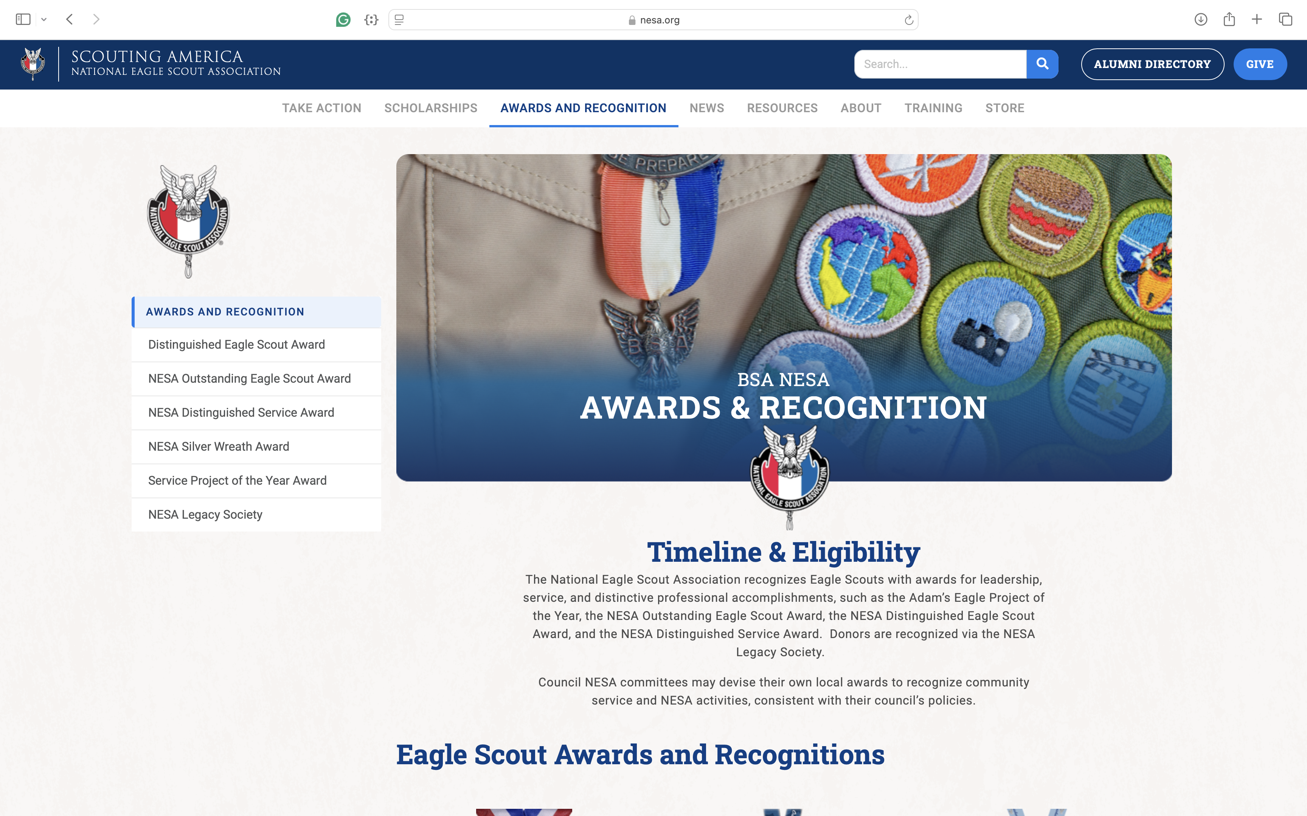
nesa.org
Notes:
Here is a screen shot of the NESA website.
The awards and recognition section is almost centered on the top bar.
Click each award and details with forms are shown there.
Scholarship info is to the left of awards for all scholarship details.
The scholarship portal is open until Jan. 31st.

Slide 15

Distinguished Eagle Scout Award
DESA
DESA recognizes Eagle Scouts who achieve extraordinary national-level recognition, fame, or eminence within their profession and/or service to the nation and have a strong record of voluntary service to their community. A recipient must have been an Eagle Scout for at least 25 years. Unless the nominee is a professional Scouter, Scouting service is not considered for the DESA.
Notes:
Starting with The Distinguished Eagle Scout award (DESA) This is NESA’s top award. The nomination must state specific reasons with supporting facts, such as how the nominee has received extraordinary national-level recognition, fame, or eminence within a specific profession.
A nominee should also have a strong record of voluntary service to his community. Such service is concurrent to a distinguished career, not in place of one.
A time-tested policy to keep nominees unaware of their nominations works well to avoid embarrassment and disappointment.
For, it is also not uncommon for nominees for BSA’s top distinguished awards to be considered more than once.

Slide 16
Distinguished Eagle Scout Award
Continued…
1 Apr. – 31 July
Nominations are accepted by NESA
1 Aug. – 30 Sep.
Internal committee review to confirm eligibility / Councils may be consulted about their nominations
1 Oct. – 30 Nov.
Committee reviews and votes on nominations
1 - 9 Dec.
Council notified of voting results / communications and media plans created
10 - 14 Dec.
Current year DESA Class is announced / DESA presentations are then scheduled for the next calendar year
Notes:
NESA has aligned the DESA nomination and selection process similar to the Silver Beaver, Antelope, and Buffalo awards, using a defined nomination timeline which changed in 2022. See the timeline listed for this process.
July ends the nominations. Mid December the new class of DESA’s are announced. Wait until you get a written confirmation from NESA before any notifications are made.

Slide 17

NESA Outstanding Eagle Scout Award NOESA
Nominee has achieved high honor or distinction in his or her career or avocation at the local, state, or territory level.
Nominee has contributed significantly through community service to other community efforts or organizations (excluding Scouting efforts).
Each council NESA committee may present two NOESA honors per year, with an option of awarding an additional NOESA for every 100 Eagle Scout ranks earned (or a fraction thereof), in excess of 100 awards certified during the previous year. Unused allotments are not carried over.
Notes:
The National Eagle Scout Association established the NESA Outstanding Eagle Scout Award to commemorate the Boy Scouts of America’s 100th Anniversary in 2010. Since its inception, the award has become an important recognition among Eagle Scouts, recognizing their distinction, with less stringent* requirements required for the prestigious Distinguished Eagle Scout Award (DESA).
Known by its acronym, a NOESA is approved by NESA’s national award committee via nomination through a local council NESA committee. The award is presented solely to Eagle Scouts who demonstrate remarkable achievements well beyond their Scouting endeavors by excelling in their careers/vocations at local, regional, or national levels. NOESA recipients Inspire others through their positive actions, demonstrating excellence in their chosen professions, hobbies, community service, and adherence to religious beliefs.
Each council NESA committee may present two NOESA honors per year, with an option of awarding an additional NOESA for every 100 Eagle Scout ranks earned, or fraction thereof in excess of 100 awards certified during the previous year. 101 can use 3 201 can use 4 etc.
The nominating council should retain details regarding actions and accomplishments that led to the nominee’s consideration for the award. Only the nomination form should be submitted to the National Eagle Scout Association by Dec 31st..

Slide 18

NESA Distinguished Service Award
NESA DSA
Recognizes those who have given a lifetime of extraordinary leadership and service nationally to NESA, resulting in a significant impact on a national or territorial level. It is awarded for dedicated service over a sustained period of years to NESA.
Recipients must be NESA members and serve NESA in a leadership and or service role.
DSA nomination forms must be complete and submitted electronically to the NESA national committee at: nesa@scouting.org.
Notes:
In 1976 NESA created this Distinguished Service Award for service to NESA, which resulted in 25 honorees between 1976 and 1989, after which time the National NESA committee was substantially reorganized. This resulted in the suspension of the award until its reintroduction in 2020. Nationally, there has been an outpouring of support to reinstate the award to better recognize those Leaders (Volunteer and Professional) that further NESA and the Eagle Scout Award, nationally. Nominations are due to NESA by October 31. Awards are presented at the following years annual meeting.

Slide 19

NESA Silver Wreath Award
Each Council NESA Committee may nominate two awards per calendar year. It is awarded for leadership and service to NESA.
Recipients must be a NESA member for at least 2 years and serve NESA in a leadership and or service role.
Nomination forms must be complete and submitted electronically to the NESA national committee at: nesa@scouting.org.
Notes:
In the mid-1970s, the National Eagle Scout Association (NESA) committee established the NESA Silver Wreath Award for service to NESA. Local Councils with active NESA Committees may recognize individual leadership and/or service by committee members via the Silver Wreath Award. The award was suspended in the 1980s and reinstated in late 2023.
Recipients must be a member in good standing of NESA for at least two years. Each Council NESA Committee may nominate two awards per calendar year. Where one of the Key Three is nominated the other two members must approve. No more that one of the Key Three can be nominated in a calendar year and in such cases, the individual considered from among the Key Three cannot take part in the selection process.

Slide 20
Glenn A. & Melinda W. Adams Service Project of the Year Award
Recognize valuable service of an exceptional nature by an Eagle Scout candidate to a religious institution, school, community, or other entity through the completion of an Eagle Scout project.
The nominations must be submitted to the council NESA committee by January 31st. The council NESA committee then selects a council winner.
On or before February 28th, the council must submit a signed copy of the completed council winner’s nomination form in a PDF format to the National Eagle Scout Association
There is only one winner per council that then competes for the one winner per CST, and those winners compete for the national winner.
Notes:
Selection of recipients begins at the local level and is conducted through the Council NESA committee. An Eagle Scout who completed an Eagle Board of Review must have their nomination in by January 31, of the following year. The Council NESA committee selects a recipient for their respective Council from the list of submitted nominations and then forwards a worthy candidate to the National Eagle Scout Association by Feb. 28th for Council Service Territory (CST) consideration.
“Territory” ESSPY recipients are selected by NESA’s CST scholarship committee. Territory recipients receive $300 available for their future educational purposes or to attend a national or international Scouting event or activity.
The recipient of the national award is then selected from among territory recipients by a special selection committee of the National Eagle Scout Association. The national recipient receives $3,500, available for their future educational purposes or to attend a national or international Scouting event or activity.

Slide 21

NESA Legacy Society
Make a direct contribution to the national NESA endowment fund to support Eagle Scout scholarships, NESA committee service grants, career networking, and encouragement for all Scouts who wear the Eagle Scout badge.
Open to any currently registered youth or adult Scouter who has first been recognized as a James E. West Fellow, regardless as to whether they are Eagle Scouts or members of NESA.
Notes:
The National Eagle Scout Association established the NESA Legacy Society in 2013 as a way for individuals to make a direct contribution to the national NESA endowment fund.
James E. West Fellowship will be confirmed prior to being granted fellowship in the NESA Legacy Society.
Donate a minimum of $1,000 dollars to the NESA Legacy Society Endowment.
Gifts: Individuals may gift a NESA Legacy Society Fellowship on behalf of someone else, e.g. in honor of an Eagle Scout, or in memory of a special individual.
If gifting a NESA Legacy Society Fellowship, the individual receiving the gift must be currently registered and a James E. West Fellow. They do not have to be an Eagle scout or NESA member.

Slide 22

NESA Scholarships
Scholarships are awarded to Eagle Scouts who have shown active participation in school, Scouting activities, and community service and who demonstrate they understand the fundamentals of service to the community, service to Scouting, and their character. They should also demonstrate that if they have a financial need, what distinguishes their financial need from others?
Notes:
Eagle Scouts must be a member of the National Eagle Scout Association (NESA) to apply.
Eagle Scouts may apply for NESA scholarships beginning in their senior year of high school through their junior year in an undergraduate program or by the halfway point of their associate degree program or skilled trade program.
Recipients may receive a NESA scholarship one time only.

Slide 23
NESA Scholarships
Continued…
Scholarship Timeline
  Eagle Board of Review Date:
  Must be on or before January 24, 2025.
  Application Portal Is Open:
  December 1, 2024, through January 31, 2025.
  Application Must be Completed and Submitted
  By 11:59 p.m. CST on January 31, 2025.
  Announcement of Scholarship Awards:
  June 10, 2025.
  For more specific information and requirements: nesa.org/scholarships
Notes:
NESA scholarships are available to Eagle Scouts currently enrolled in or accepted by an accredited educational institution as a full-time student (at least 12 credit hours) in a program leading to an academic degree (including associate degrees) or a skilled trade program.
Cooke four-year scholarship awardees must be enrolled in an accredited four year college or university as a full-time student (at least 12 credit hours) in a program leading to a bachelors degree.
NESA scholarships are not available to students attending any of the U.S. military academies.
• NESA scholarships are not available to graduate students pursuing a master’s or doctoral degree.
See all details on the scholarship site.

Slide 24
Important Due Dates
Alumni Awards & Recognitions
NESA Awards & Recognitions
Alumnus Awards, Dec 31st
Alumni Awards, No Deadline
Council Distinguished Alumni, No Deadline
Council Alumni Committee, Dec 31st
Alumni Service Commemoration, No Deadline
DESA , April 1 to July 31st
NOESA, Dec. 31st
NESA DSA, Oct 31st
Silver Wreath, Dec. 31st
Adams Eagle Scout Service Project, Jan 31st
NESA Legacy Society, No deadline
Scholarships, Dec. 1 to Jan. 31st
Notes:
Here is a list of the awards we reviewed and the due dates. Take a screen shot or photo of this list. Please keep this in mind to get your nominees in the selection process. Remember recognition is a vital part of the scouting program.

Slide 25
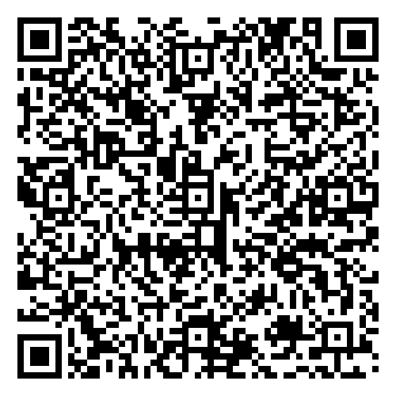
To help us improve these webinars, please complete this survey.
Visit us at:
scoutingalumni.org
and
nesa.org
Notes:
Please use your phones camera and scan this QR code to provide us with feedback on this award presentation. Ask any questions that you have in the Q&A section

Slide 26
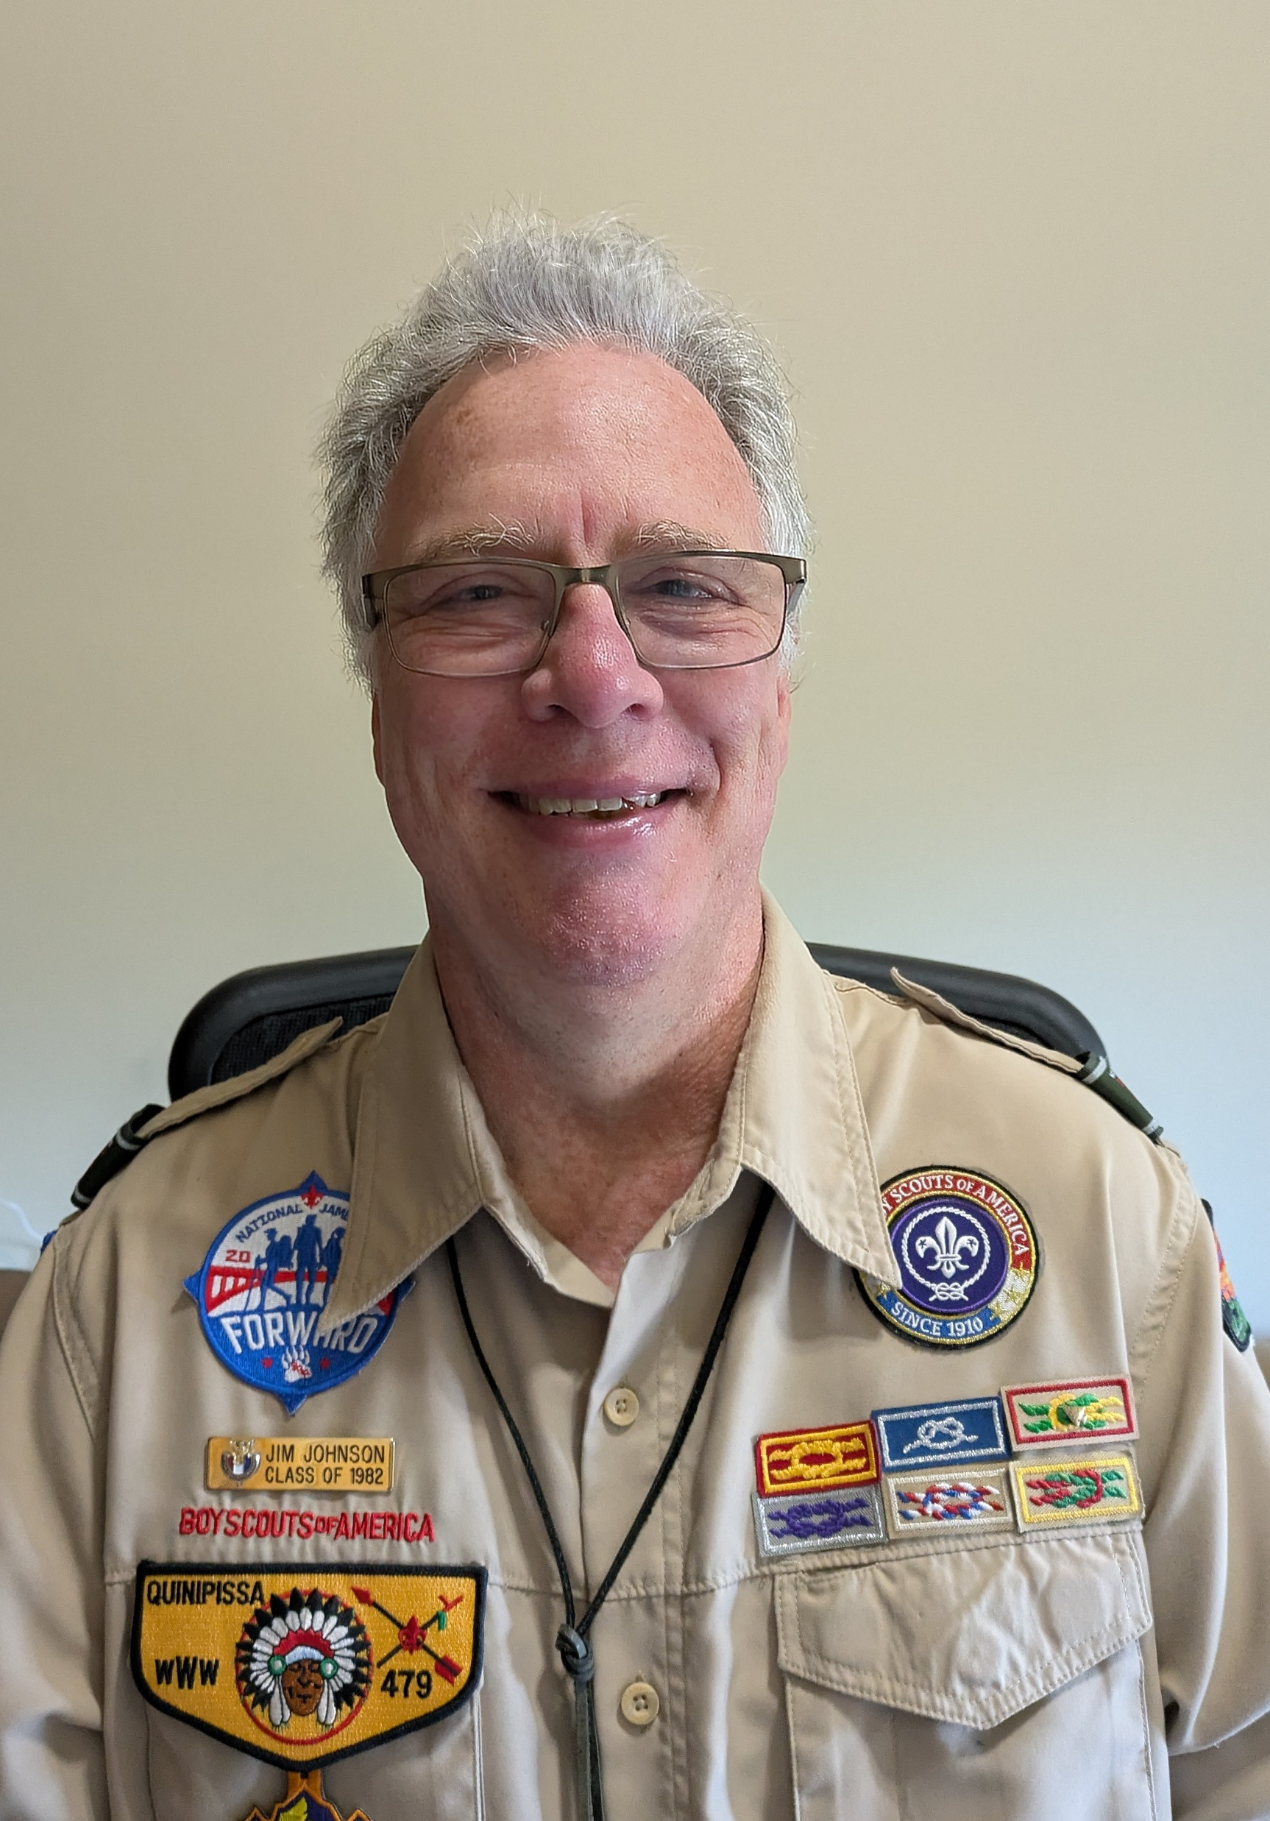
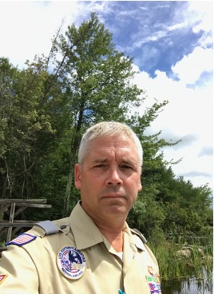
Questions?
Jim Johnson
wamegojim@gmail.com | (336) 991-6053
Bill Kropa
N3evz@rcn.com | (570) 499-0838
Notes:
Please type any additional questions on Alumni or NESA in the Q&A section. Please visit the website for all the details on these awards discussed today. We thank you for taking the time to attend this session.
This session will be posted online for viewing and use for council committees at a later date.

Slide 27
Upcoming Webinars…
Our next webinar will take place on Sunday, February 2, 2025, at 3:00 PM Pacific, 4:00 PM Mountain, 5:00 PM Central, and 6:00 PM Eastern.
The Topic will be “How to Put Together a Camp Reunion.”
Notes:
Here is information to save the date for our next webinar in February at the same start time.

