Slide 1
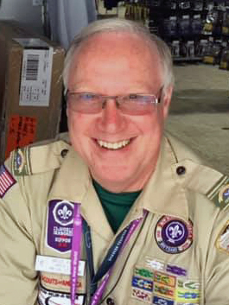
Earning your
BSA Alumni Award
October 6, 2024
Presented by:
Bruce Hamous
NESA Vice President – Retail Operations
BSA Alumni Association – Central Territories
Council Support Coordinator &
CST-4 Alumni Chair
Mid-Iowa Council
Ross Arnold (Host)
NESA Vice President – Training

Slide 2
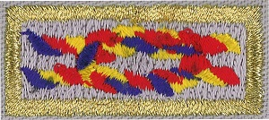
BSA Alumni Award
Application driven process
Complete 13 of 24 specified tasks in 6 categories
Comparable to Scouter’s Training Award
A recognition program to encourage participation and work in council alumni relations programs, including NESA and other affiliate groups
Begin with declaring intent to earn the Award (please don’t “go back in time”)
By earning the award, you will be encouraging engagement of unregistered or inactive BSA alumni

Slide 3
What is the BSA Alumni Association?
Purpose of the BSA AA
Foster lifelong relationships for BSA Alumni
Encourage BSA Alumni gifts of time, talent, and philanthropy to Scouting
Facilitate volunteer service to achieve established goals related to vibrant BSA Alumni membership programs
Simply put:
“The BSA Alumni Association exists to reengage former Scouts and Scouters and those who have been involved in or supported Scouting in the past and bring them back to the Scouting Campfire”
Every Scouting America Council should have an active Alumni Committee

Slide 4
What (Who) is a BSA Alumnus?
A BSA Alumnus is anyone who:
Has been positively impacted by the Scouting America Program
Supports Scouting in any number of ways
Enjoys Scouting Adventures
Helps boys & girls grow into their very best future selves

Slide 5
Who Can Earn the Alumni Award?
The following are the eligibility requirements to earn the
BSA Alumnus Award
Applicants must be currently registered with the Scouting America program as an Adult member
Applicants must register with the BSA Alumni Assoc. https://resources.scouting.org/get-involved/signup
Applicants must be a member of a council with an Active BSA Alumni Committee
Applicants should be an Active Member of either a local council Alumni Committee or a local or national Alumni Affiliate or Affinity Group

Slide 6
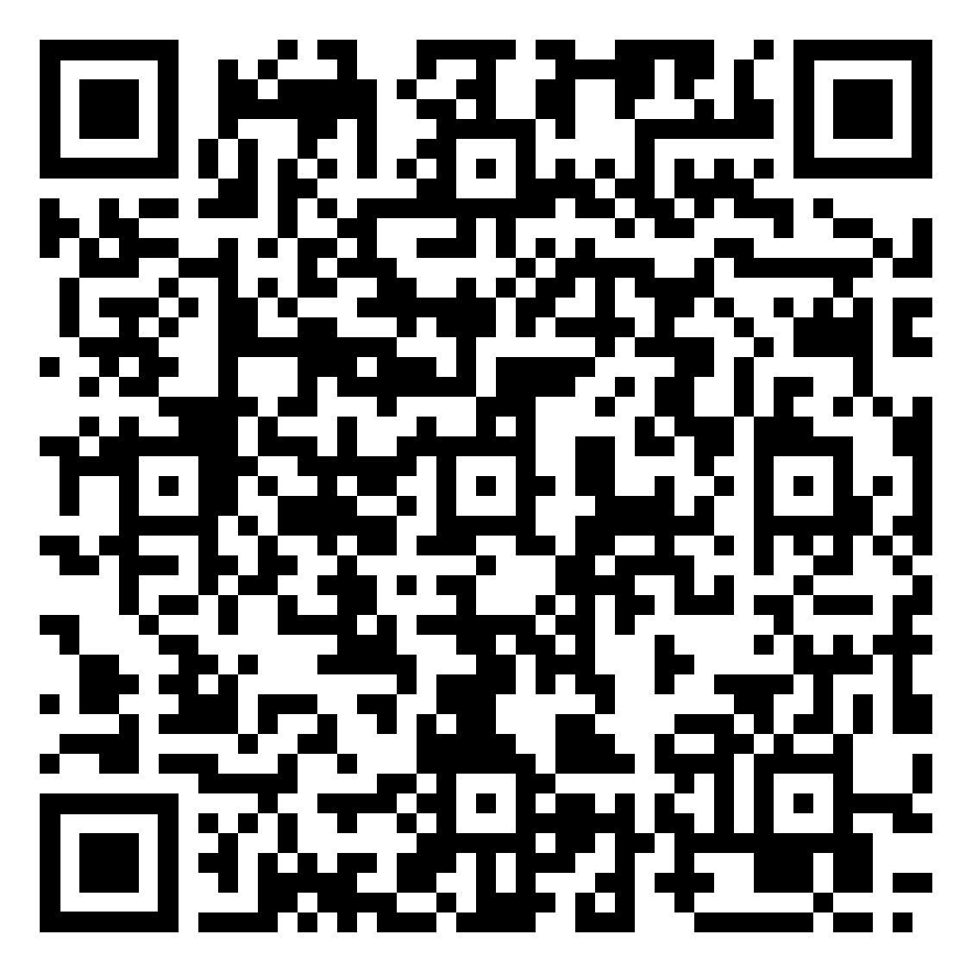
Where to I find a copy of the Alumni Award Application?
http://scoutingalumni.org/wp-content/uploads/2021/10/Alumni-Award-Requirements-6.1.21-Fillable.pdf

Slide 7
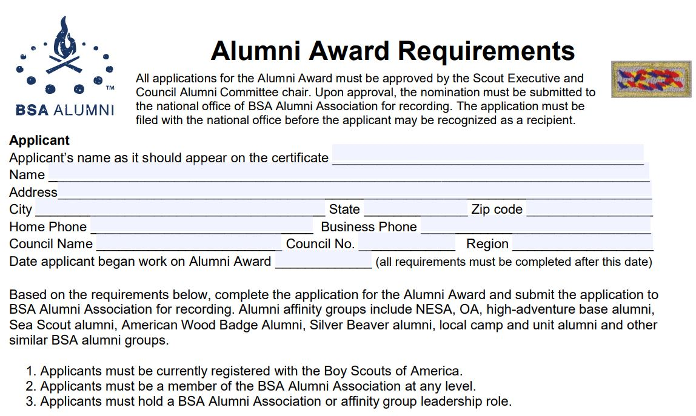
CST

Slide 8
The Requirements for Earning the Alumni Award are Divided into the Following 6 Categories
Memories
Marketing
Mentoring
Membership
Manpower
Money

Slide 9
Requirements
I. Memories (Complete 2 of 4)
1. Participate in a BSA Alumni Association, affinity group or unit/council . reunion or event
2. Assist in planning, organizing and implementation of an alumni activity . with your BSA Alumni Association committee or alumni affinity group.
3. Create and distribute communication approved by your council designed . to identify and engage alumni.
4. Distribute BSA Alumni Association marketing materials at a public event . (i.e., state or county fair, Scout-O-Rama, etc.) to alumni and learn about . their Scouting experiences

Slide 10

II. Marketing (Complete 2 of 4)
1. Use activity photographs to promote BSA Alumni Association or an . alumni affinity group
2. Make two presentations to non-Scout groups promoting the BSA and . volunteerism
3. Write a minimum of two paragraphs about how Scouting has impacted . your life. Share your “Scouting story” on a Scouting social media site . (unit, council, national), community blog, or letter to the editor
Facebook https://www.facebook.com/BSAAlumniScouts
Twitter https://twitter.com/BSAalumni
4. Present Alumni Service Commemoration(s) to 25, 50 or 75 years to 3 qualified Alumni

Slide 11
III. Mentoring (Complete 3 of 5)
1. Give a tour of the BSA Alumni Association website to a gathering of alumni
2. Assist three alumni in updating their profile www.scoutingalumni.org . including alumni affinity memberships, when applicable.
3. Complete the online training series for alumni in the BSA Learning Center at . www.my.scouting.org
4. Attend an BSA Alumni Association seminar in your council, Council Service Territory or online Alumni Training Workshop (like today)
5. Attend a BSA Alumni Association course at the Philmont Training Center, . the Summit Bechtel Reserve or other national BSA training facility

Slide 12
Available Training
Training Module on My.Scouting.org (67 Minutes – self guided)
BSA AA Creating the Committee
BSA AA The Committee Chair's Role
BSA AA The Scout Executive's Role
BSA AA Affiliate & Affinity Group Relationships
BSA AA Awards and Recognition
BSA AA Communications
BSA AA SPARK Database General User
BSA AA SPARK Database Specialist
https://training.scouting.org/learning-plans/1200?bc=W3siaWQiOiIvY2F0YWxvZyIsImlzUGFyZW50Um91dGUiOnRydWUsImtpbmQiOiJscCIsInRleHQiOiIiLCJzZWFyY2hQYXJhbXMiOiIiLCJ1dWlkIjoiL2NhdGFsb2cifV0=

Slide 13
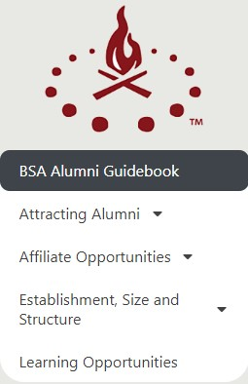
Available Training
BSA Alumni Guidebook on ScoutingAlumni.org Website
https://scoutingalumni.org/resources/guidebook/

Slide 14
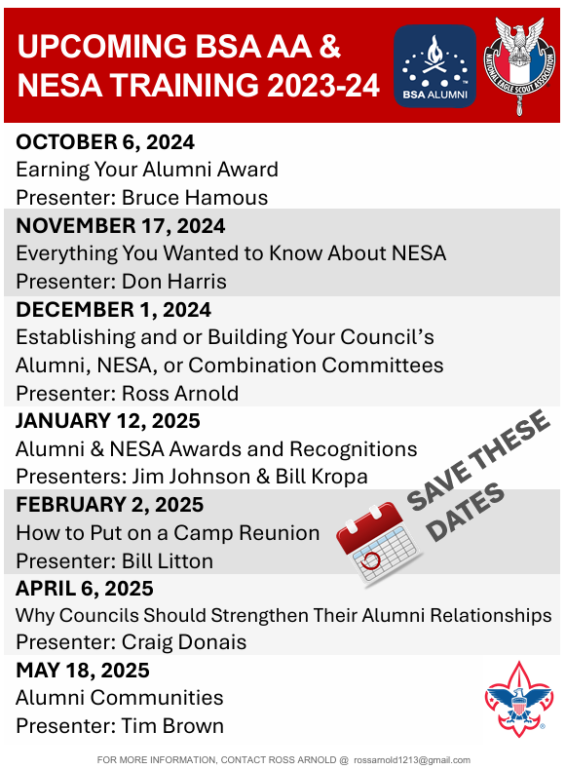

Slide 15
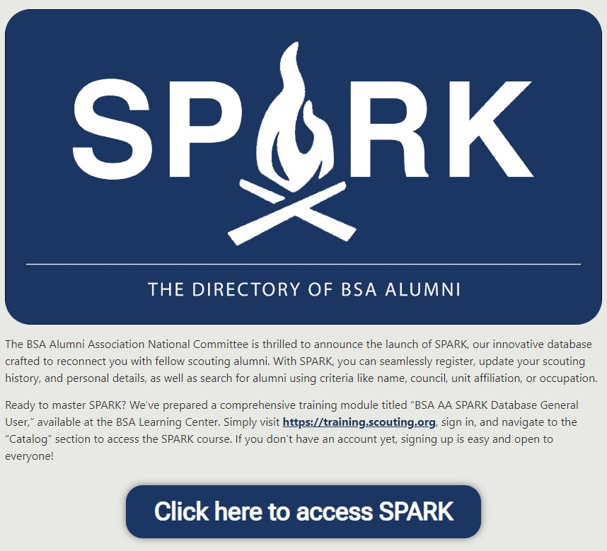

Slide 16
IV. Membership (Complete 3 of 6)
1. Facilitate registration of at least two alumni as members of the BSA
2. Assist two alumni to register on the BSA Alumni Association website
https://scoutingalumni.org/get-involved/signup/
3. Assist formation of a council or Council Service Territory BSA Alumni . Association or alumni affinity group committee
4. Serve on a BSA Alumni Association or alumni affinity committee for at . least two years
5. Be or become registered as a member of an alumni affinity group
6. Assist two alumni to register online to become members of an alumni . affinity group

Slide 17
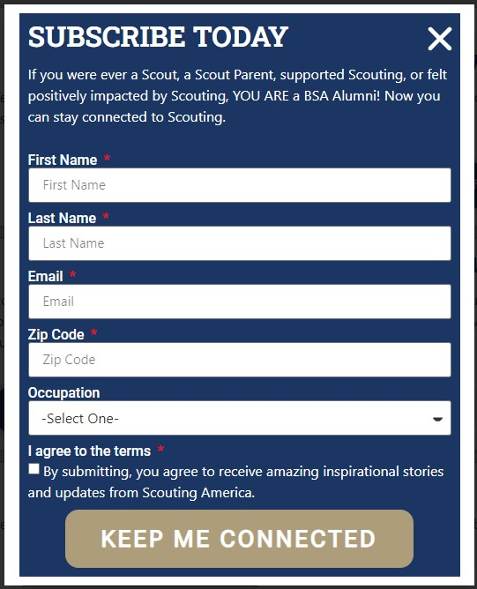
Get Connected!
Go to the ScoutingAlumni.org website (link below)
Click on the “Get Involved” button
Fill out the Registration form and begin receiving the monthly BSA Alumni Association online newsletter
https://scoutingalumni.org/get-involved/signup/

Slide 18


















BSA Alumni Association
Affiliate & Affinity Groups
BSA Alumni Committee

Slide 19
Requirements (Continued)
V. Manpower (Complete 2 of 3)
Arrange for at least two unregistered alumni to attend a Scout activity
Contact at least five adult alumni not currently registered with the BSA, engage them in a serious discussion about the Scouting program
Meet with a local charter partner or Scouting unit and discuss ways to recruit alumni and how that could benefit both organizations.

Slide 20
Requirements (Continued)
VI. Money (Complete 1 of 2)
Encourage two unregistered alumni to make a Friends of Scouting donation.
2. Encourage at least two registered alumni to make a meaningful (based . on the donor’s ability to give) financial donation to Scouting over and . above regular dues and contributions, i.e., any gift that aids Scouting

Slide 21
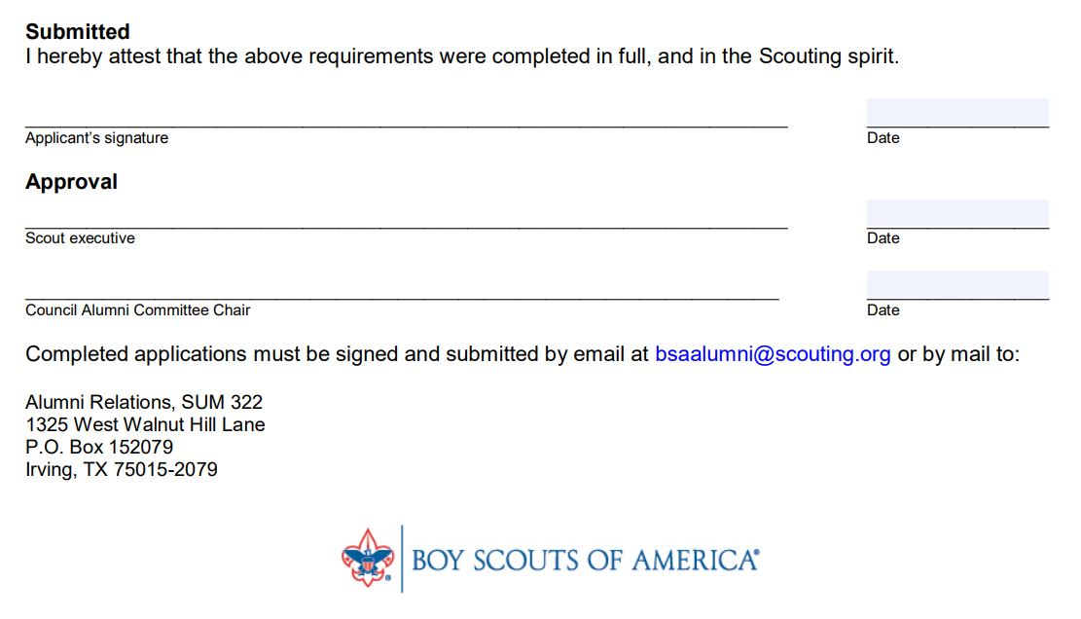
Completion Approvals

Slide 22

Next Steps?
Visit the ScoutingAlumni.org website and sign-up with the BSA Alumni Association
Download the BSA Alumni Award Application
Use the “Council Alumni Committee” finder button on the website
Option A: Contact the Council Alumni Committee chair to ask to join the committee
Option B: Contact your Scout Executive and consider volunteering to start an Alumni committee in your council

Slide 23
Contacts
Alumni Award Form https://scoutingalumni.org/wp-content/uploads/2021/10/Alumni-Award-Requirements-6.1.21-Fillable.pdf
To sign up for the Educators Affiliate group https://docs.google.com/forms/d/e/1FAIpQLScOrN5xGbhVDRaeEt7-85DXwTKjpuBVJPdL5jRf_tILSw5dSA/viewform?fbclid=IwAR2p5VIefNkCq7zSG8oZF6-ITqXMxW8XDK1r3voVTY1FZvQ38JFI-5qUGqE
Alumni Communities Lead Tim Brown bsaalumnicommittee@gmail.com
Career Based Affinity Group Lead Joe Kruzan, josephkruzan@aol.com
Sign Up BSA Alumni Assoc. https://scoutingalumni.org/get-involved/signup/
For assistance in forming a BSA Alumni Committee in your council contact, BSA Alumni Council Support Chair Jay Bottorff, jsbottorff1@gmail.com
NESA Vice President of Training Ross Arnold, rossarnold1213@gmail.com

Slide 25
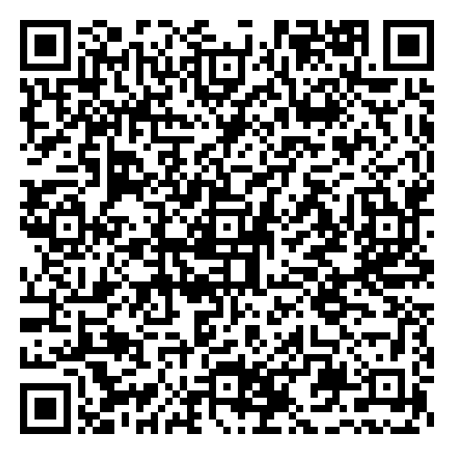
Post-Training Survey
https://docs.google.com/forms/d/e/1FAIpQLSc9yPfTZWobzGF4Nv_INru7t42Q1pFlN6lwk6G-aO4DqrCnug/viewform?entry.1064980786=October+6,+2024

Slide 26
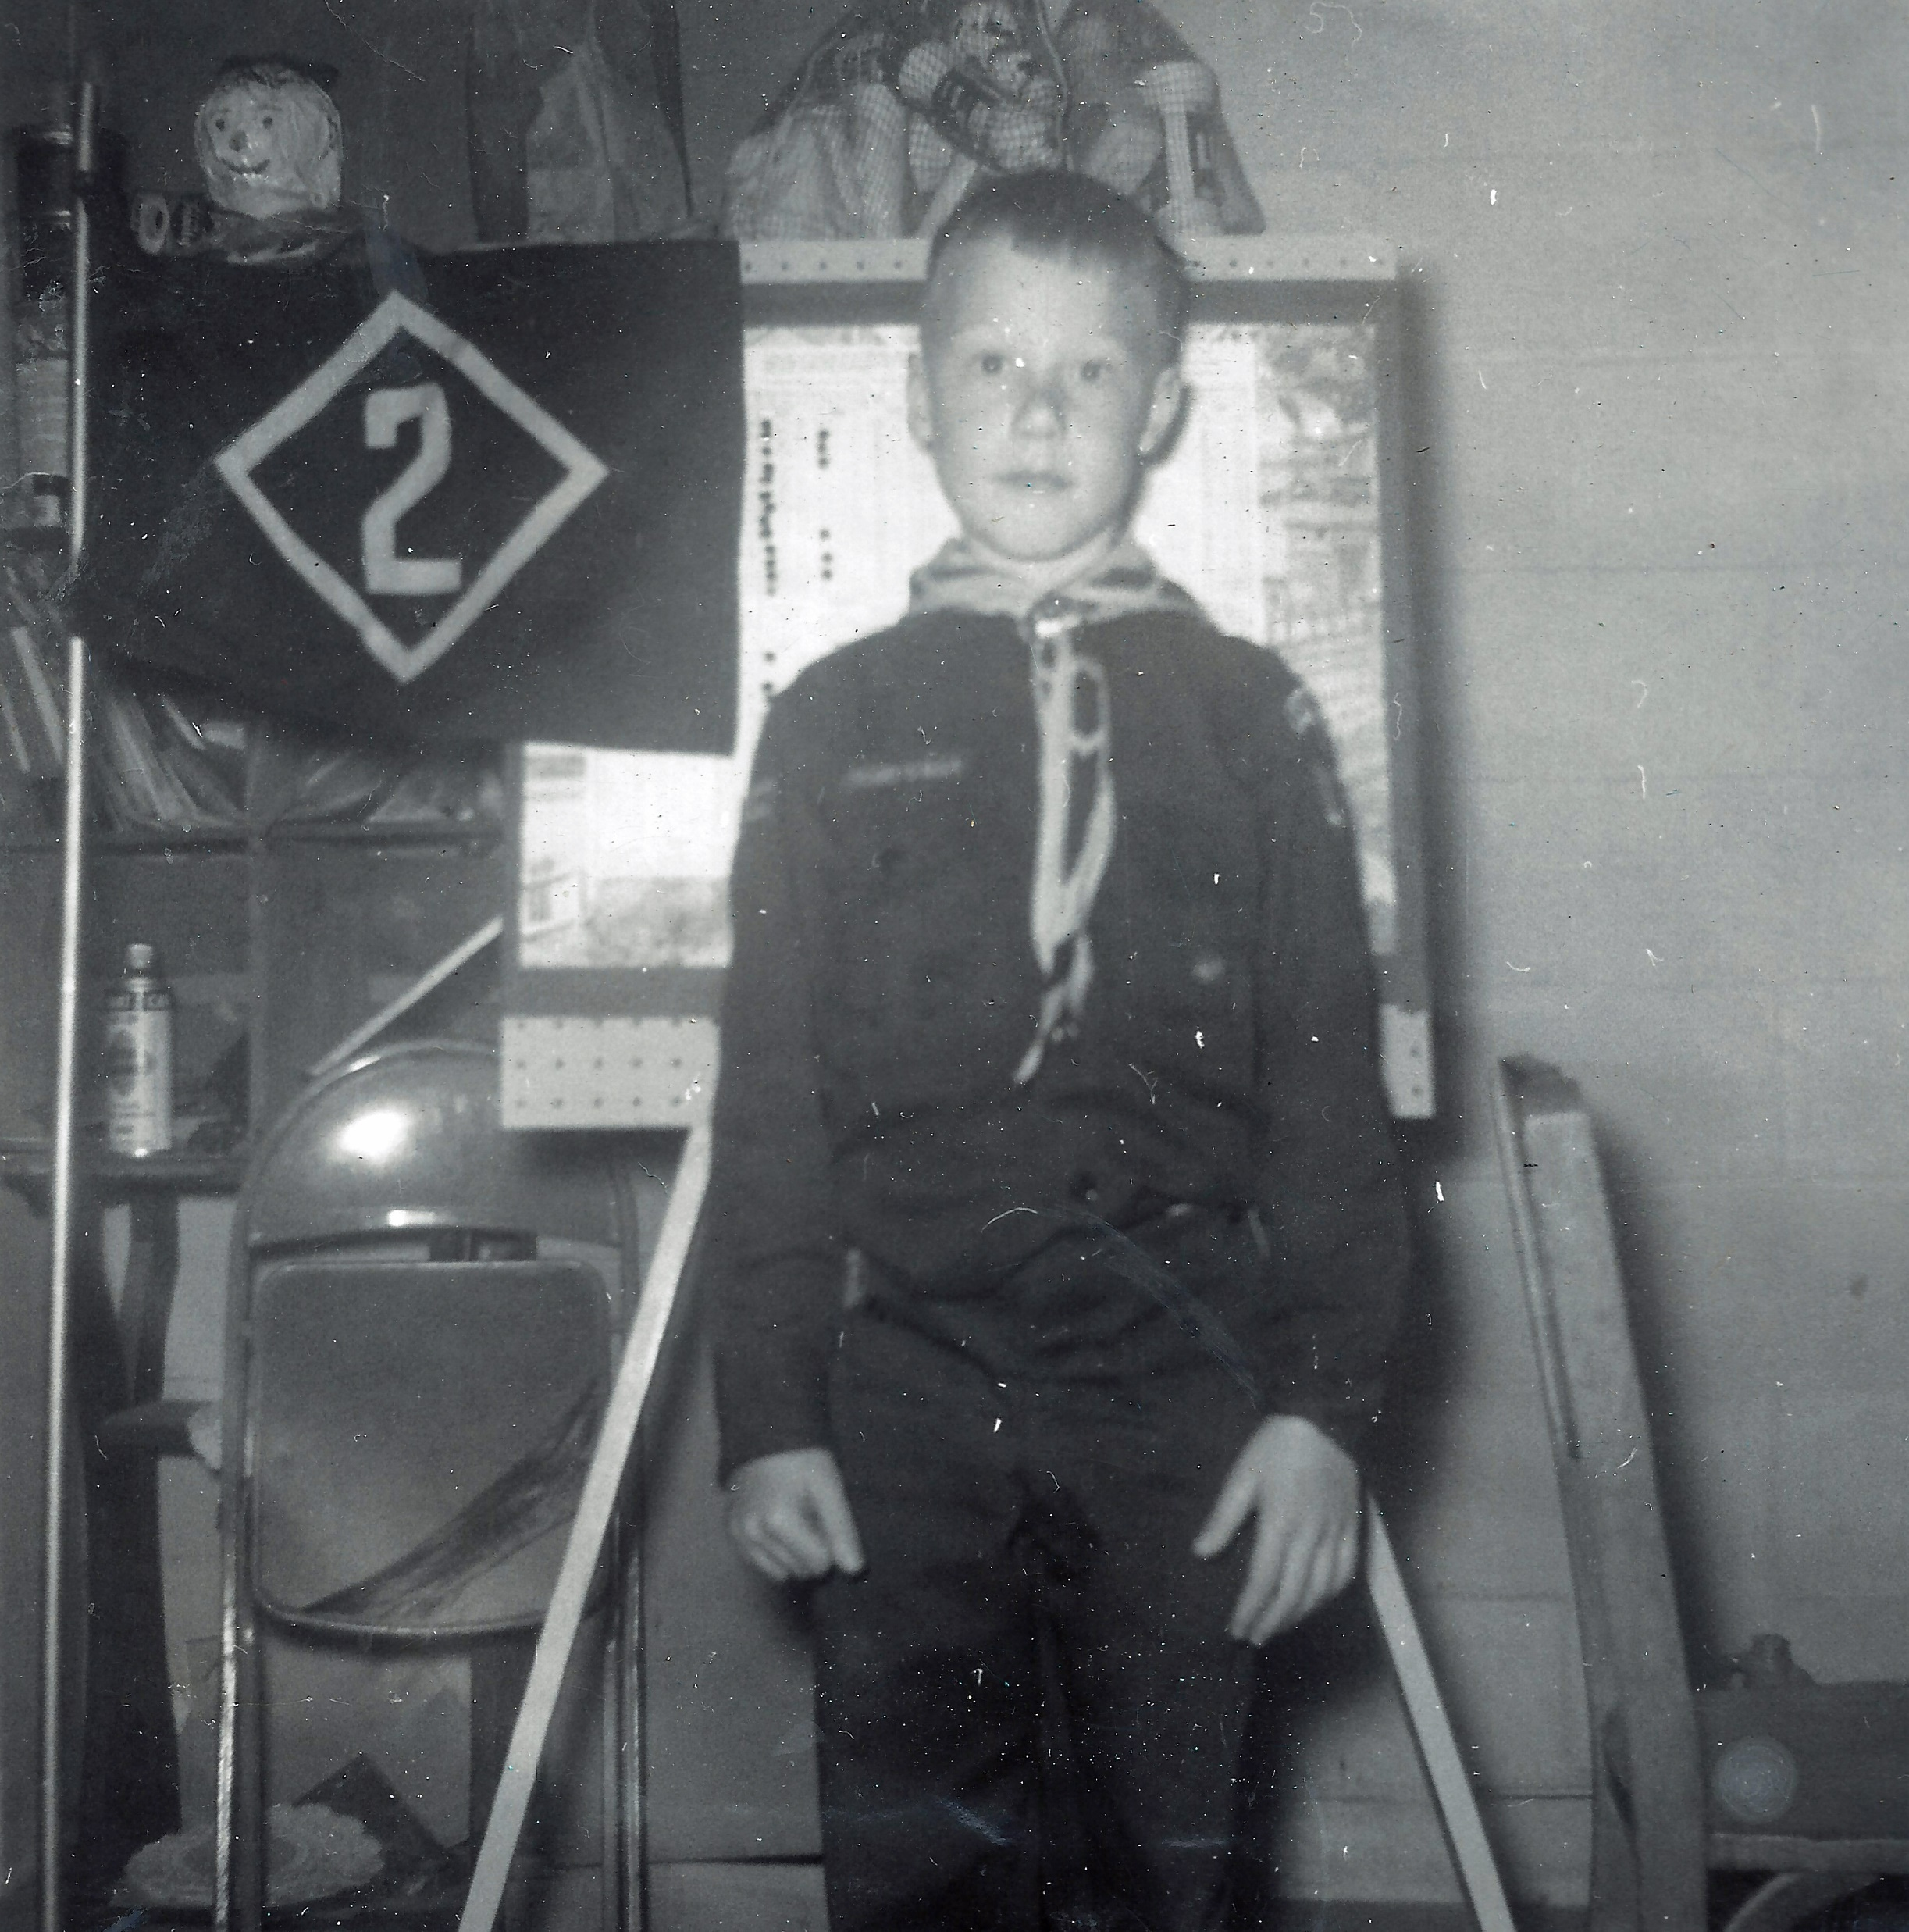
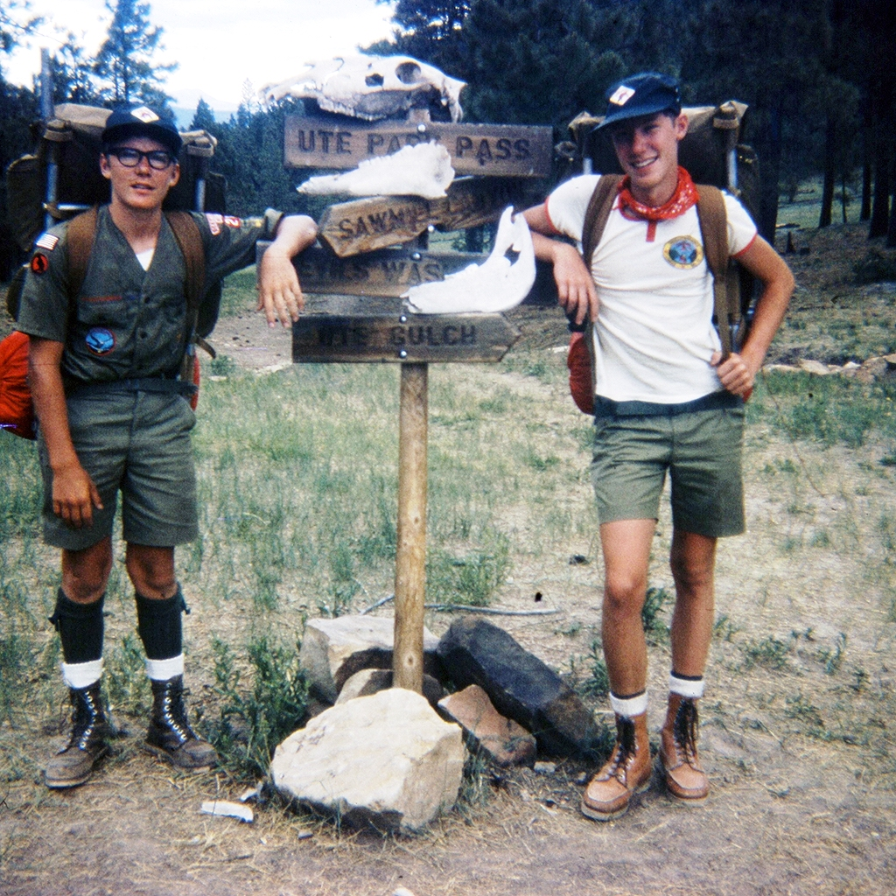
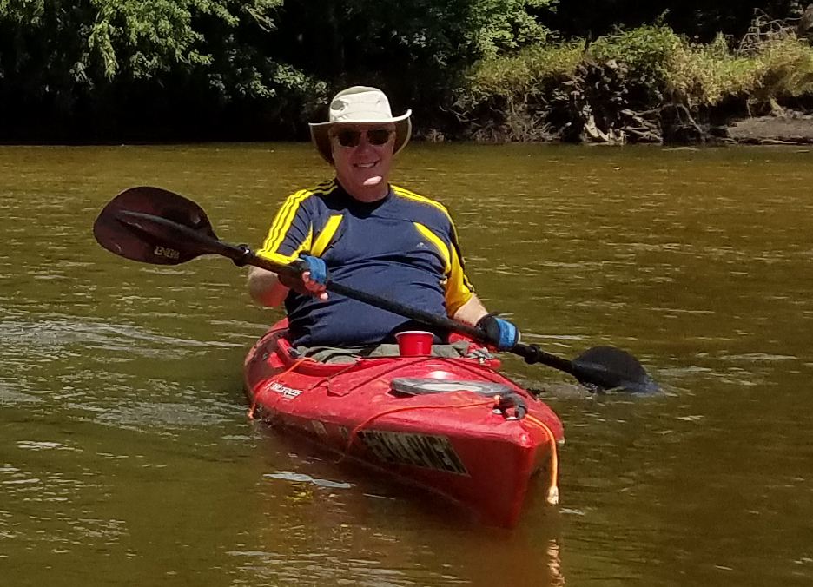
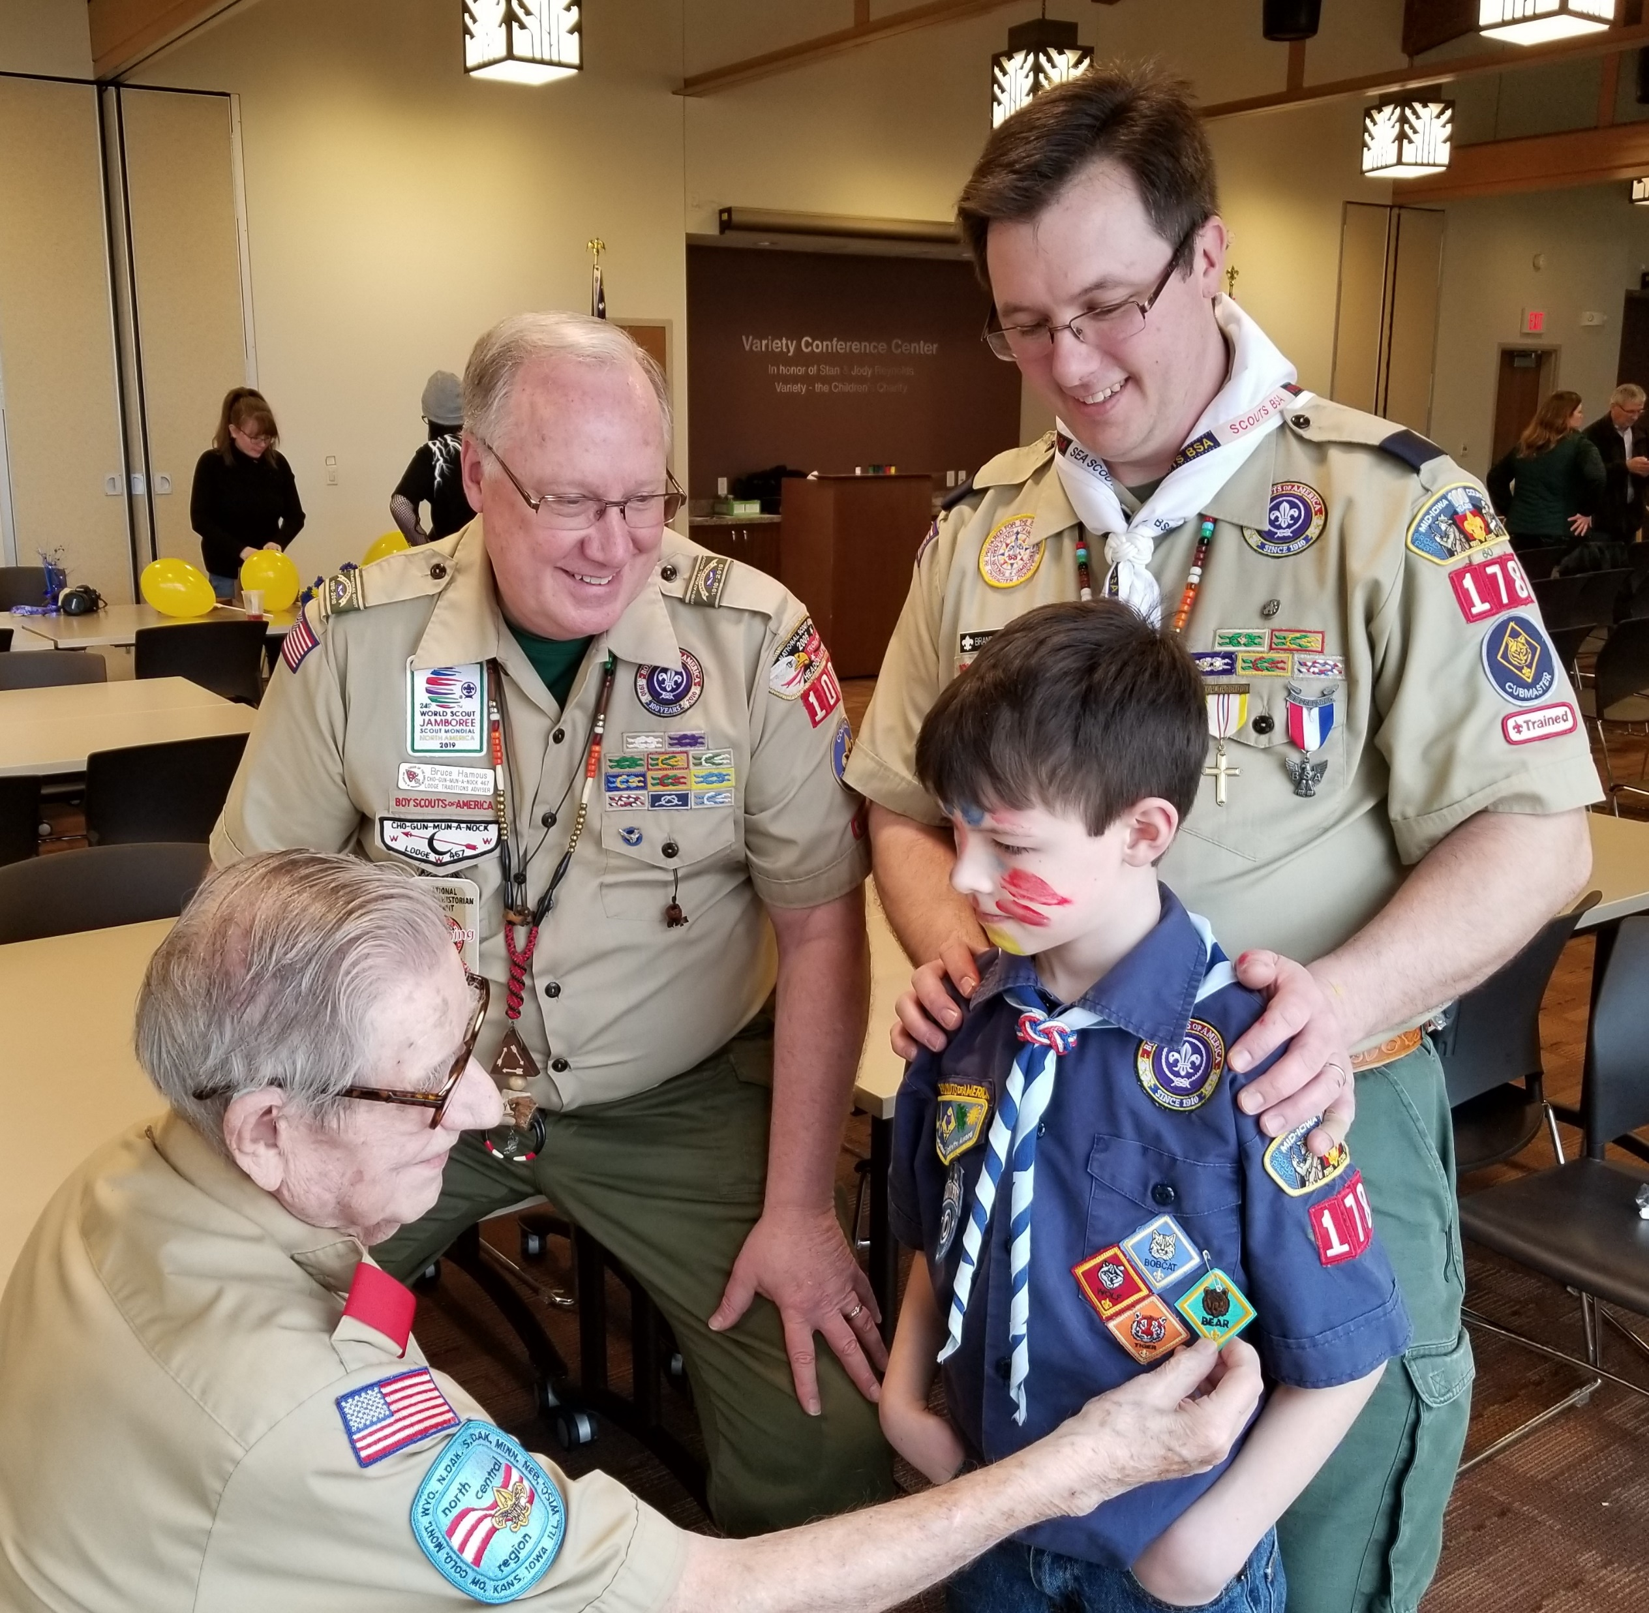
Questions??
Bruce Hamous
bruce.hamous@gmail.com
(319) 551-9522 (cell)

