Slide 1


Why Councils Should Strengthen Their Alumni Relationships
April 6, 2025

Slide 2
Who Are Scouting Alumni?
“Scouting America defines Scouting Alumni as anyone who has ever been personally impacted by Scouting!”

Slide 3
Why Are Scouting Alumni Important?
Simply put, there are no better ambassadors for the Scouting program than Scouting Alumni.

Slide 4
Purpose & Presentations
What is the purpose of this session:
To Illustrate Why Councils Should Strengthen Their Alumni Relationships

Slide 5
The Untapped Potential
Quite honestly, Scouting Alumni may be Scouting’s most untapped potential…
Especially in terms of its potential for:
Increased Volunteerism
Shared Positive Life Experiences
Subject Matter Expertise
Personal Finances, etc.

Slide 6
View on Alumni Engagement
Many believe that alumni engagement is possibly the best tool to attract those who have been personally impacted by Scouting back to the campfire, then it will be to attract those who will be experiencing Scouting for the first time, especially since a lot of what they have heard about Scouting has been negative.

Slide 7
Potential Opportunities for Scouting Alumni
The opportunities for Scouting Alumni are nearly endless, and include things such as:
Boards of Review / Unit Commissioners
Merit Badge Counselors / Subject Matter Experts
Providing Resources (Materials, Finances, Contacts)
Service (Unit / District / Council / Community)
And the list goes on…

Slide 8
Missed Opportunities for Councils to Engage Alumni
With the seemingly endless opportunities for Scouting Alumni to add value to councils, one would think that every council would have strong Alumni Relations. However, that is not the case. Currently, nearly 25% of councils have no organized Alumni Committee or engagement.

Slide 9
Understanding Why Councils Resist Alumni Engagement
The reasons that councils resist actively engaging their Scouting Alumni are varied:
Lack of understanding the benefits
Limited council leadership buy-In
Other priorities (Membership, Finances, Potential Merger, etc.)
Limited professional staff
Unwilling volunteers

Slide 10
Breaking Down Barriers to Alumni Engagement
“Historically, councils who actively engage their Scouting Alumni tend to have more opportunities for success than those who do not!”
The above statement should be the motivation that council leadership needs to begin to develop strong alumni relations. Once they buy-in, things happen…

Slide 11
Recognizing a Council’s Existing Alumni Activity
Recognizing a council’s existing Alumni activity may be the first step in gaining the buy-in from council leadership. Illustrating what is currently taking place makes the thought of further developing Alumni Relations seem less daunting.
Samples: Gathering of Eagles / Wood Badge Reunions / Camp Staff Weekends / Troop Anniversaries / OA Fellowships

Slide 12
Alumni Engagement
Engagement Opportunities:
  @ Scouting Events
    - Alumni or Eagle Scout Recognition Events
    - Unit / District / Council Events
  @ Service Events
    - Service to Scouting
    - Service to the Community
  @ Social /Special Events
    After Hour Social
    Camp Anniversaries, Reunions, etc.

Slide 13
Next Step - Committee Formation
When a council recognizes the volume and frequency of its own Alumni activity, the value and impact of Alumni engagement becomes more evident. Typically, such realizations give councils pause to consider formally creating an Alumni Committee to better organize, expand and promote their Alumni engagement.

Slide 14
Creating an Alumni Committee
The Council President and Scout Executive collectively find a dedicated, alumni-centric volunteer to serve as the Alumni Committee Chair. The Chair reports to the Council President, or possibly to a Council Vice President of Alumni Relations. The Committee Chair then recruits a minimum of three Vice Chairs: Membership, Engagement, and Communications.

Slide 15
Building Relationships
1. Alumni events should not be financial sponsorship or membership recruitment events.
2. Financial solicitation should not be part of a group presentation, rather be one-on-one & down the road.
3. Membership and volunteer opportunities should be noted, not pressed. Have something in mind when asked.
4. LISTEN
5. FOLLOW UP

Slide 16
Committee Expansion
The Alumni Committee then begins to recruit additional Committee members to assist with the identification of, the conducting of outreach to, and the meaningful engagement of the council’s Scouting Alumni.
Remember, Alumni Relations is all about building relationships. If you establish trust with your Scouting Alumni, and if they feel that they are meaningfully engaged, they will continue coming back to the campfire year after year.

Slide 17
Available Alumni Resources
Scouting Alumni and the National Eagle Scout Association have a variety of proven resources to aid councils and their Alumni Committee(s). These include:
Scouting Alumni Website: https://scoutingalumni.org
NESA Website: https://nesa.org
Spark Directory: https://directory.scouting.org
Committee Guidebooks
Guide to Hosting a Scouting Alumni Reunion
Toolkit for Forming a Camp Alumni Association

Slide 18
Council Service Territories
Another valuable resources to councils and their Alumni Committees are the Council Service Territories (CSTs). All the Scouting America’s CSTs have an Alumni Chair to assist councils with the Alumni relations needs. They can provide councils with a variety of resources including training, communication, and many proven best practices.

Slide 19
Alumni Training
There are numerous alumni-related online training modules on training.scouting.org. Simply login to your my.scouting.org. Then type the keyword search for “Alumni”.

Slide 20
Alumni Training Modules
Creating the Committee
The Committee Chair's Role
The Scout Executive's Role
Affiliate & Affinity Group Relationships
Awards and Recognition
Communications
SPARK Database General User

Slide 21
Alumni Communities
Scouting Alumni has a subcommittee for Alumni Communities. These communities are made up of Alumni Affiliate & Affinity Groups, designated Scouting America partners (i.e., Civic and Community Based Organizations).
Scouting Alumni can find “connection points” amongst these groups with those who have similar interests and shared experiences.

Slide 22



























Scouting Alumni Umbrella
https://scoutingalumni.org/get-involved/alumni-communities/

Slide 23
In Closing
If your council is not actively seeking to engage their Scouting Alumni, they should be.
If they are, then seek ways to expand the engagement, to be more inclusive. Widen your umbrella.
Remember, the art of Alumni engagement is simply building lasting relationships.
Scouting grows stronger through Alumni.

Slide 24
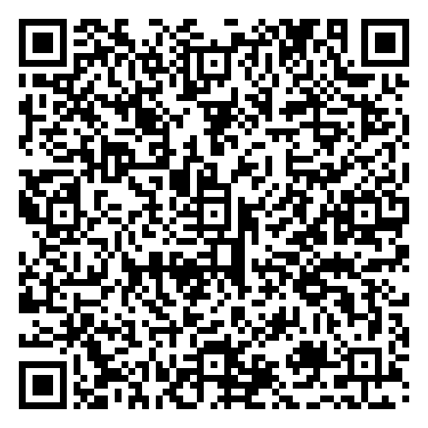
To help us improve these webinars, please complete this survey.
Visit us at:
scoutingalumni.org
and
nesa.org

Slide 25
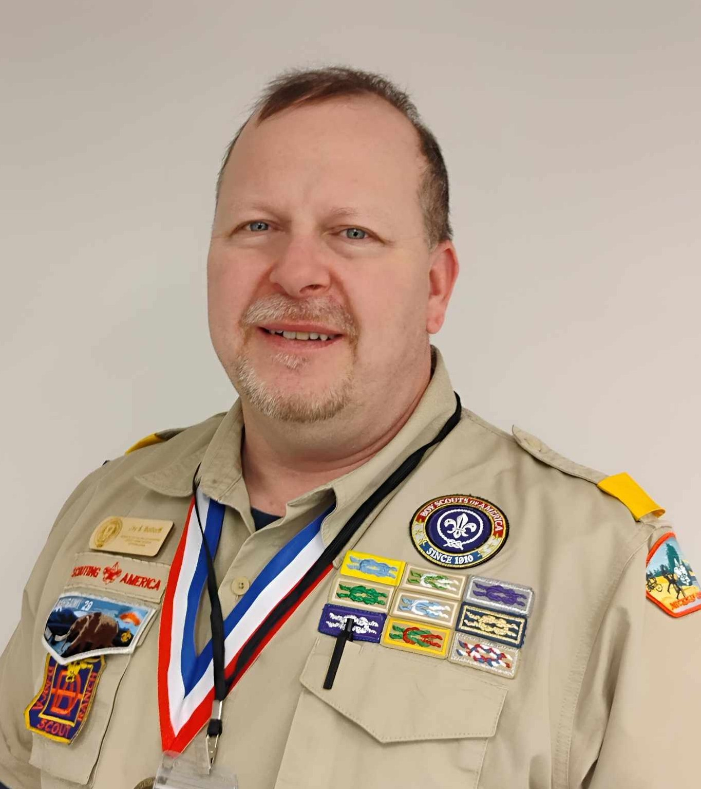
Questions?
Jay Bottorff
Scouting Alumni - Council Support Lead
jsbottorff1@gmail.com | (313) 633-5810

Slide 26
Upcoming Webinar…
Our next webinar will take place on
Sunday, June 1st at
3:00 PM Pacific Time
Topic: Alumni Communities
Presenters: Bradley Taylor and
Tim Brown

